Slide 1

KS3 ICT
Hardware &
Software
Hardware:
Input, Output & Storage Devices
KS3 ICT
Hardware & Software

Slide 2
Lesson Aims
1
To understand the term Hardware
2
To understand the terms Input, Output and Storage Device
3
To be able to list examples of the above

Slide 3
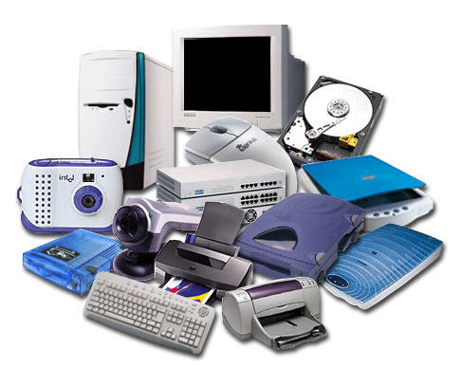
Hardware
What is Hardware?
Hardware is the physical parts of a computer system
In other words, the parts of the computer you can touch

Slide 4

Hardware
What is an Input Device?
An input device is a piece of hardware that allows the user to put data into a computer system

Slide 5
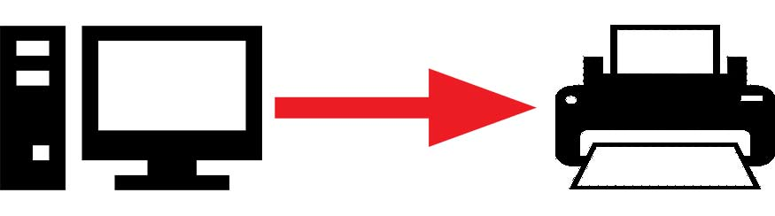
Hardware
What is an Output Device?
An output device is a piece of hardware that allows the user to receive information from a computer system

Slide 6
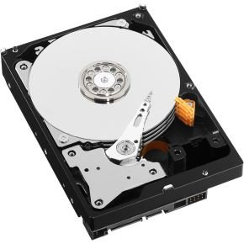
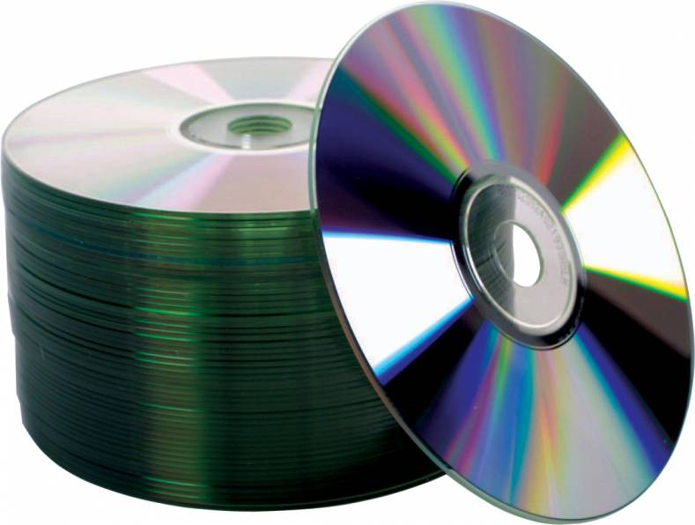
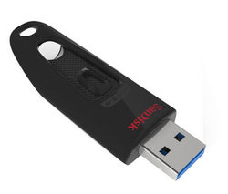
Hardware
What is a Storage Device?
This allows a user to install programs and save their files on a computer
The device retains this information when the power is switched off, this means it is a permanent storage
There are three categories of storage devices.

Slide 7
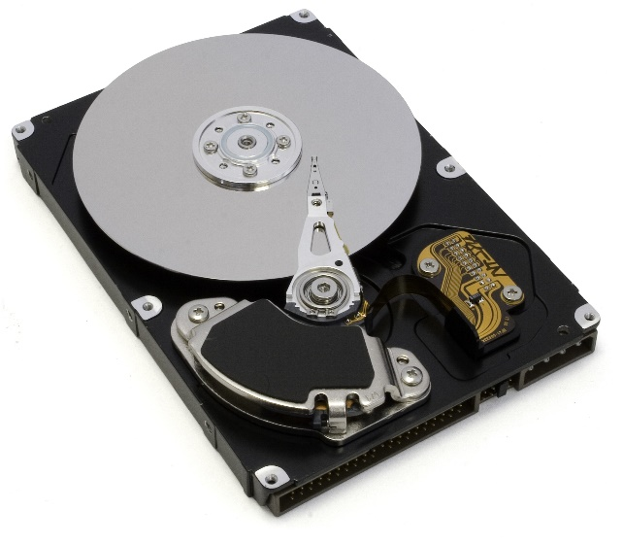
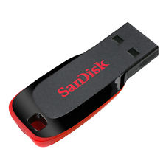
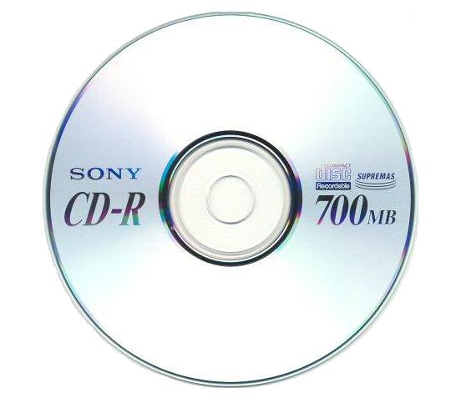
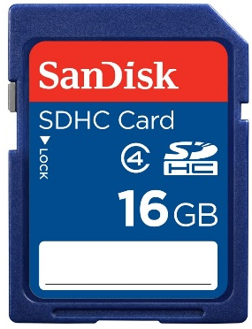
Hardware
There are three categories of storage devices
Magnetic
Optical
Solid State
Works by magnetising and demagnetising the surface of a spinning disk.
Works by altering parts of a disc that can or cannot reflect a laser beam.
Uses flash memory and has no moving parts.
Example: Hard Drive
Example: CD/DVD/Blu-Ray
Example: USB Stick/SD Card

Slide 8
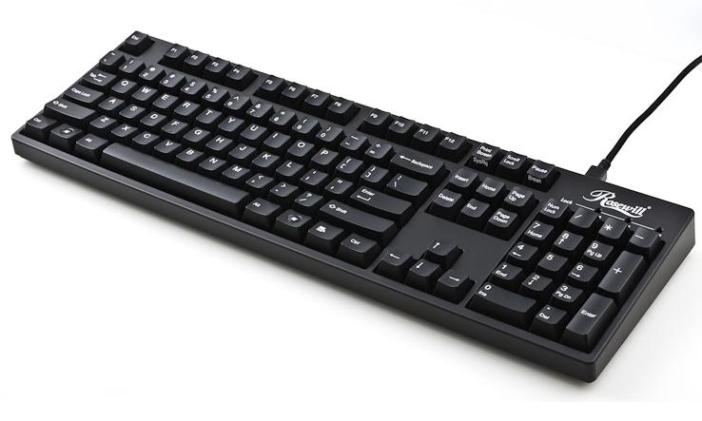
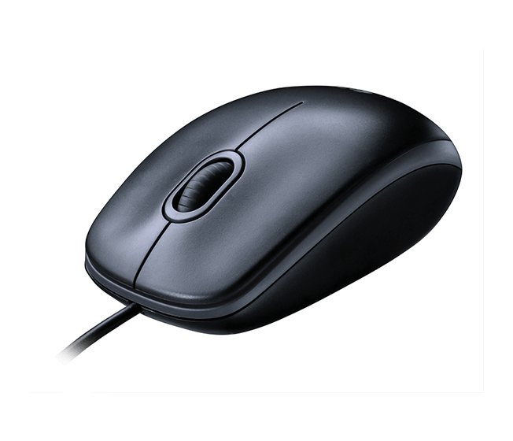
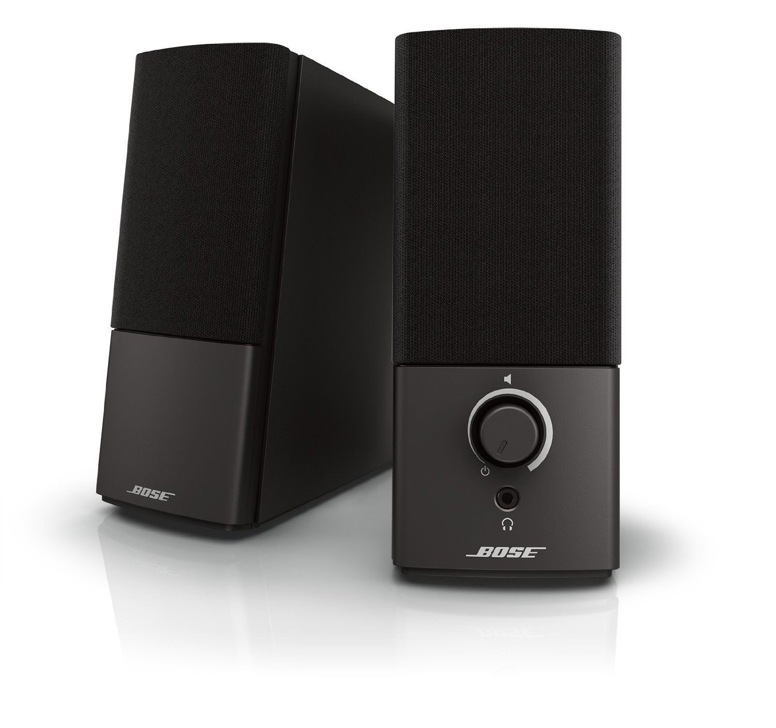
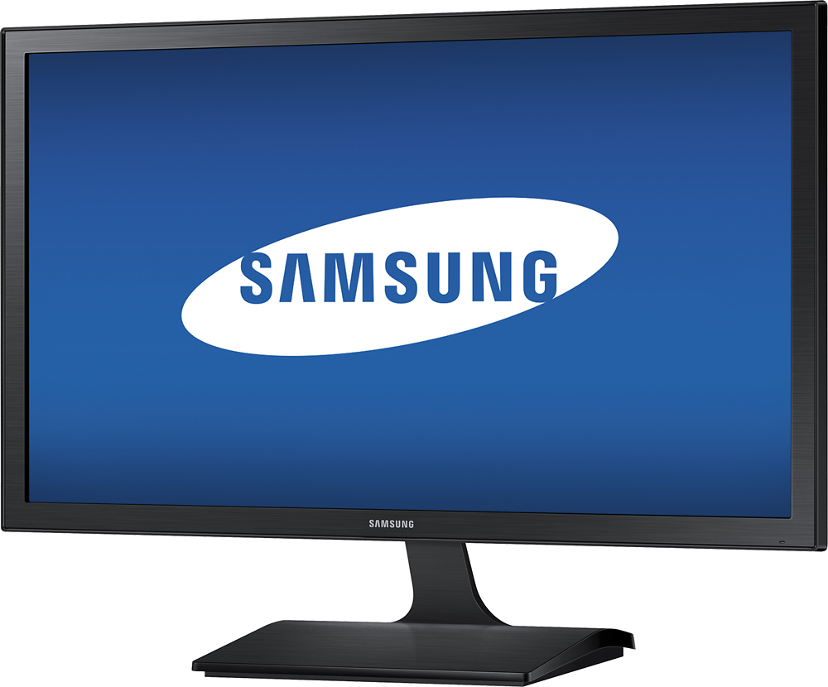
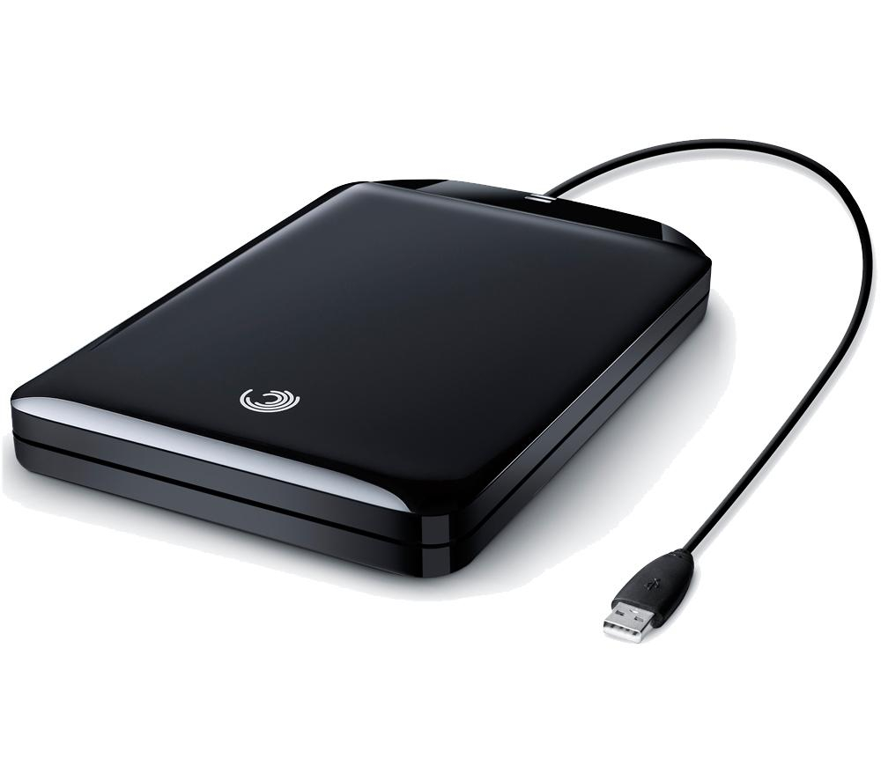
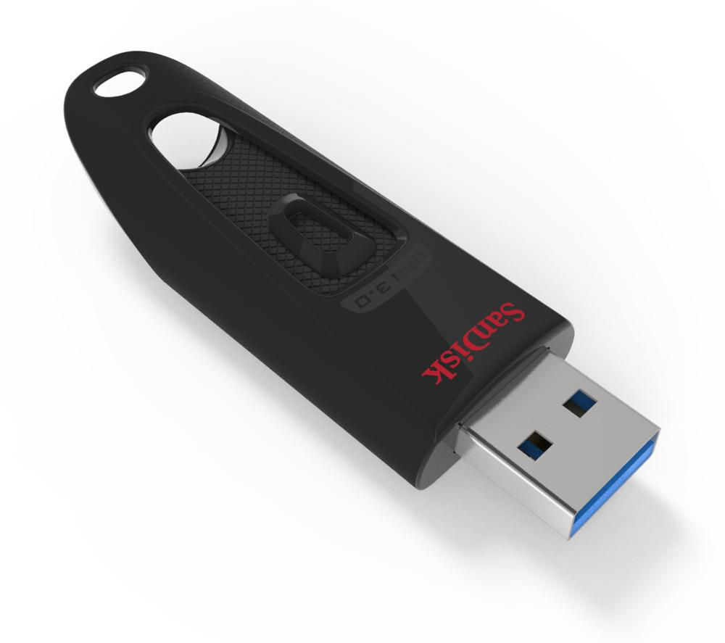
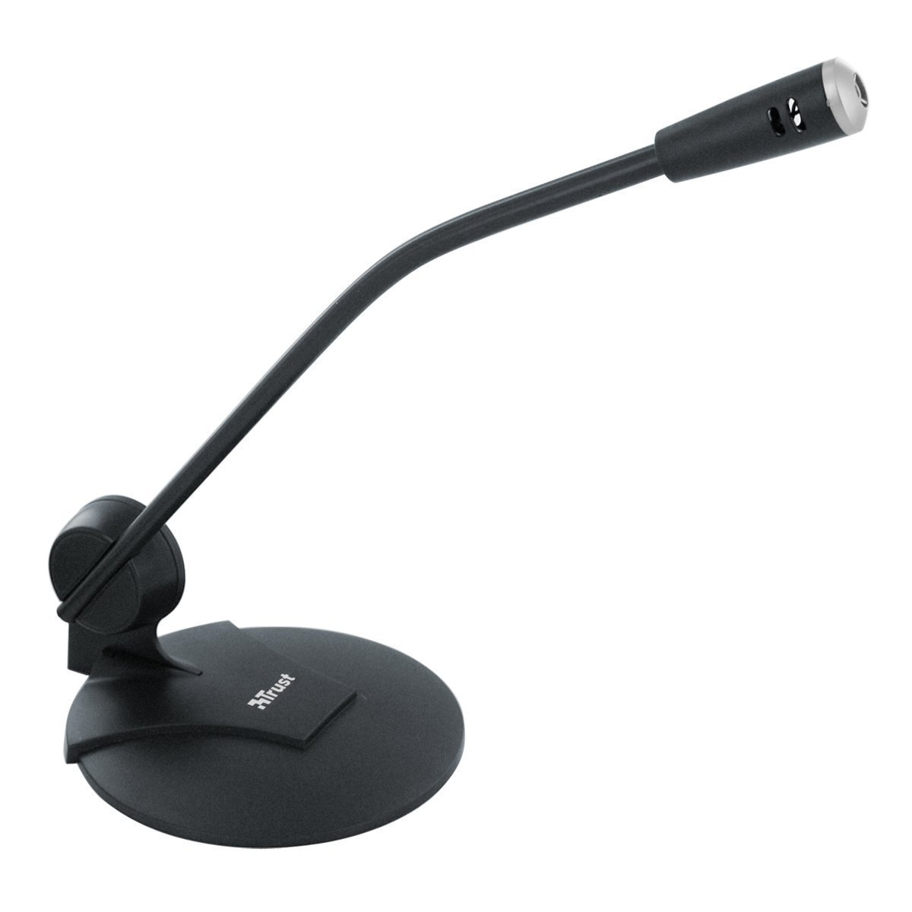
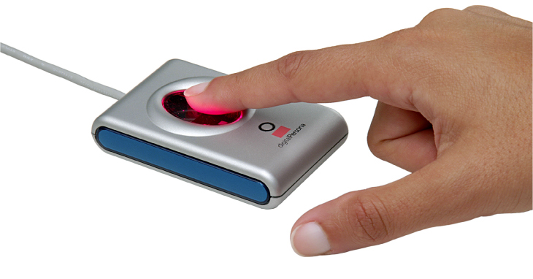
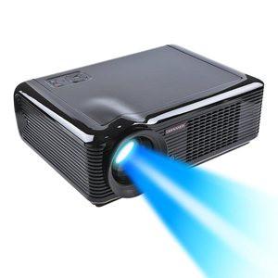
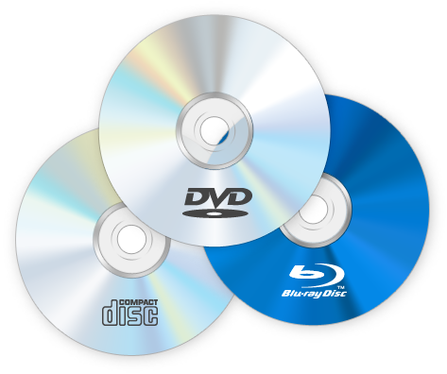
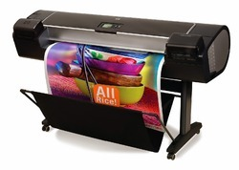
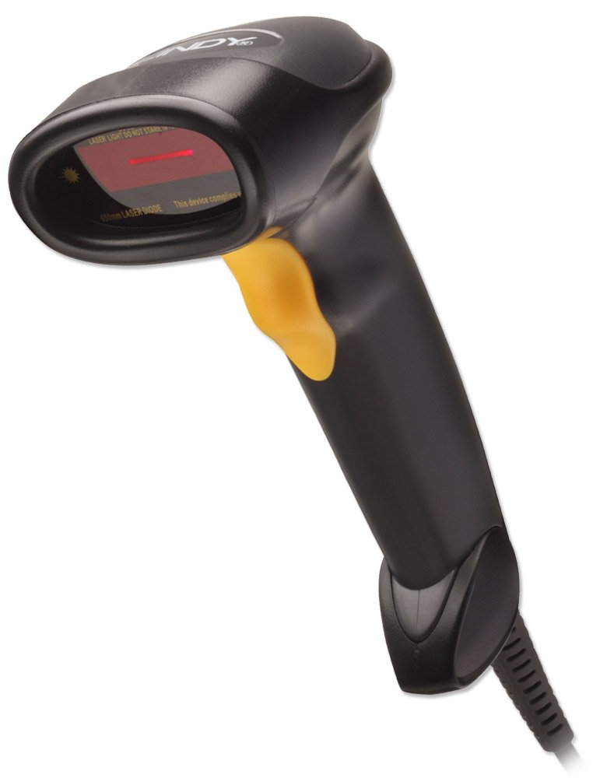
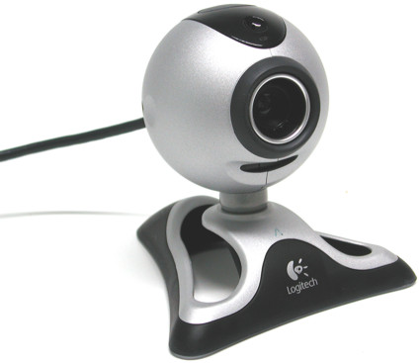
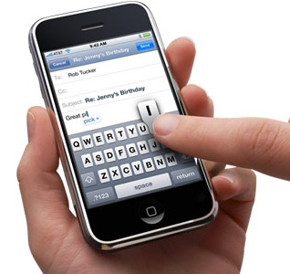
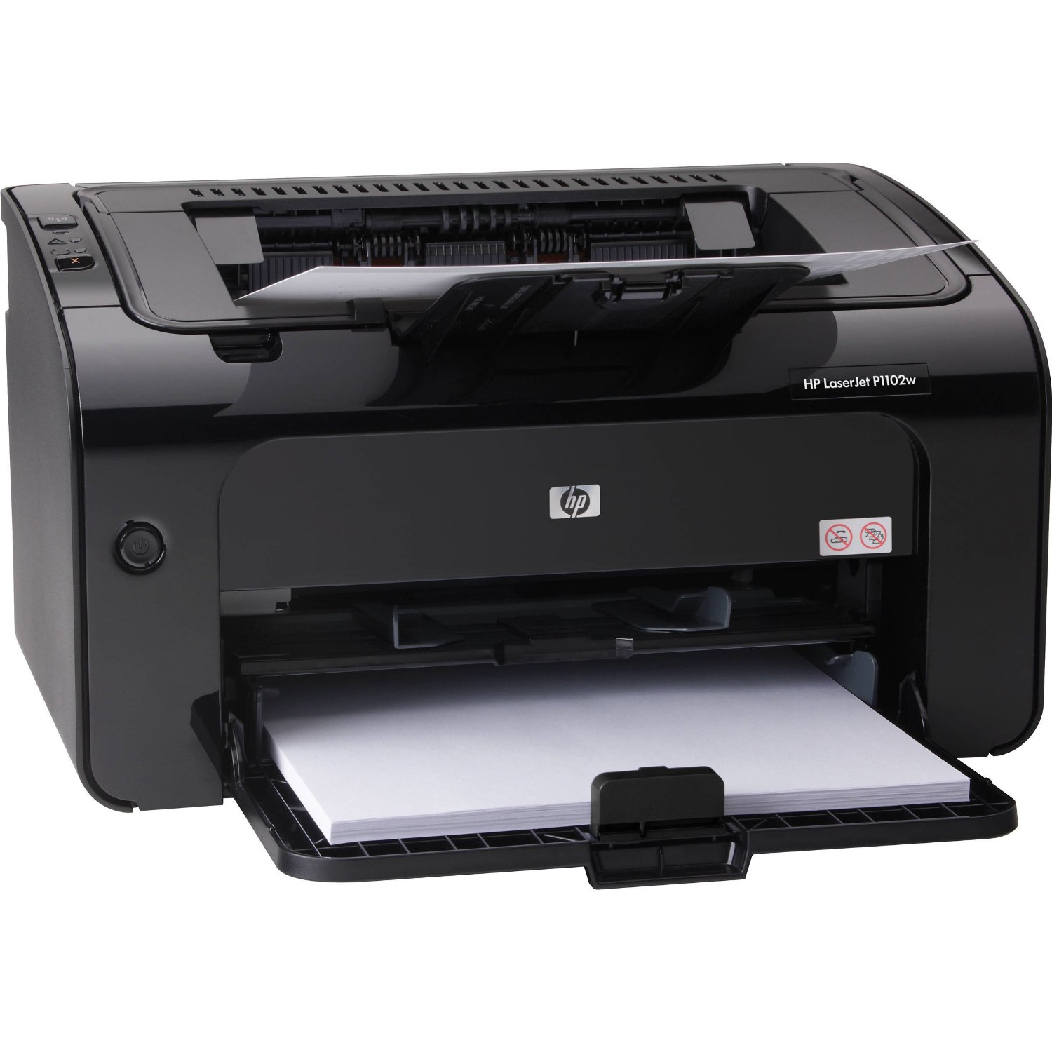
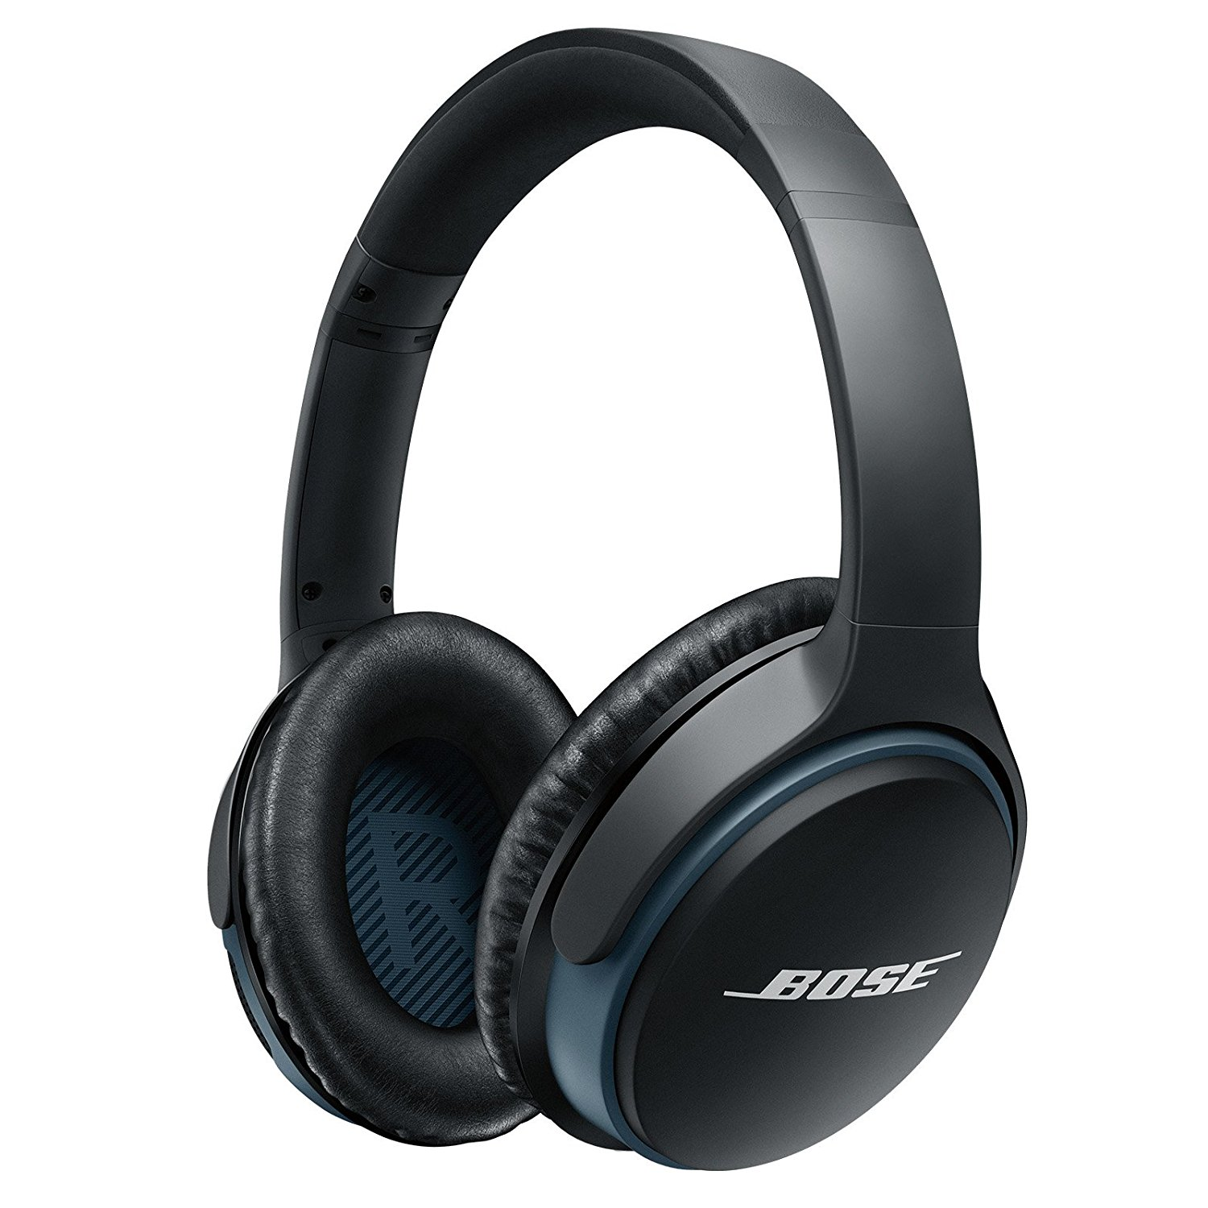
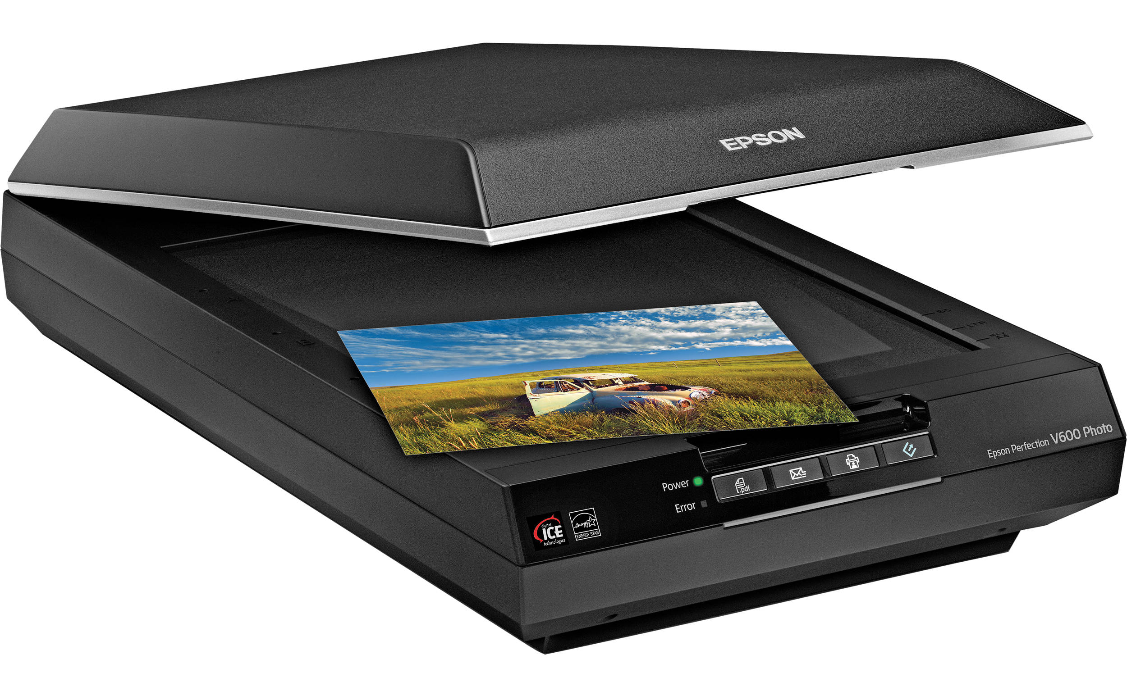
Examples
Below are examples of each type of device
Input Devices
Output Devices
Storage Devices

Slide 9

Glossary
Achievement Unlocked!
Glossary Term Added
Data:
A collection of facts without context, such as values or measurements. On a computer, ‘data’ can be stored as files, emails, video games, songs, pictures, data logged by sensors and calculations carried out by the central processing unit (CPU).
Compute:
The verb ‘to compute’ means to carry out mathematical calculations. Today, with electronic computers everywhere, the term is more commonly defined as the use of computers to solve problems.

Slide 10
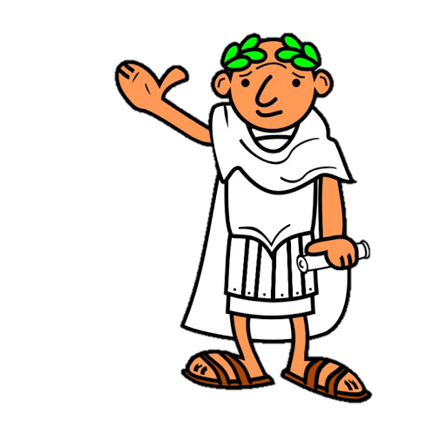
To Compute
The word ‘compute’ is derived from the Latin word ‘computare’, which means ‘to count up’, ‘to sum up’, ‘to reckon together’.
The Romans certainly did not have computers and ‘to compute’ does not mean to use a computer.
Computing is something that we all do whenever we perform a mathematical calculation.
The electronic computer is not the first device that people have used to help them to compute.
For many centuries mathematicians have been inventing tools to help them to carry out calculations with greater speed and accuracy.

Slide 11
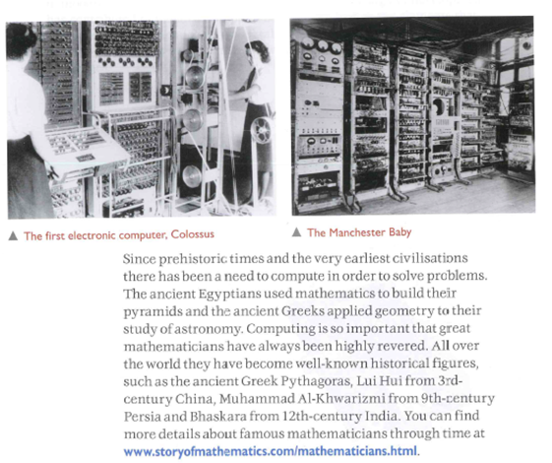

Slide 12

Raspberry Pi
One small computer is the raspberry pi, the credit-card sized computer that you can plug into the TV and a keyboard. Can you locate the processor, the memory, the storage and the input and output?

Slide 13
Glossary Recap
Achievement Unlocked!
Glossary Term Added
Information:
Once data has been processed and given meaning, it can be termed information. For example, data would be ‘16’ whereas information would be ‘Alex has just turned 16’. It is now clear what the piece of data is relating to.

Slide 14
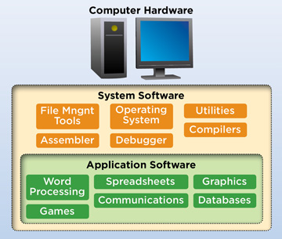
Software is the word used for the actual programs that allow the hardware to do a useful job.
Without software, hardware is useless.
Software are the applications and instructions needed to make the computer hardware do useful work.
Some examples of system software which tells the computer what to do:
Operating System (OS)
Utilities
User Interface
Some examples of application software which allow you to do your work:
Word processors such as Microsoft Word
Spreadsheets such as Microsoft Excel
Databases such as Microsoft Access

Slide 15
Input
When a computer accepts data for processing. Input devices are used to convert information that humans can understand into the coded electrical signals that the computer can process.
Storage
A computer can store data. Secondary storage devices are external memory used to store programs and data not currently in use.
Process
A computer can calculate, sort data and make decisions based on the information to be found in the program being used. An example of processing would be the computer running a spell check.
Data Communications
A computer can send data over a long distance. This is done through Data Communications (including telephone lines and satellites).
Output
When the computer sends out information after processing. Output devices convert the computer’s signals back into human readable form.

Slide 16
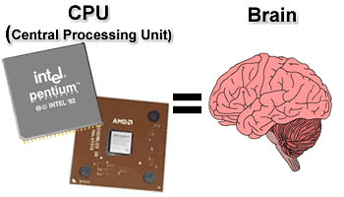
The Central Processing Unit
When buying a computer, it may state that the computer operates at, say, 2 GHz for example. GHz stands for Gigahertz and the term refers to the processor speed of the CPU. The higher the Gigahertz the faster the processor will be.
The Central Processing unit, or CPU, is sometimes described as the computer’s brain.
It is an important part of the computer system and it usually consists of a single integrated circuit (chip).
It isn’t as complicated as a human brain though.
It thinks more like a function machine, which you might have come across in maths lessons.

Slide 17
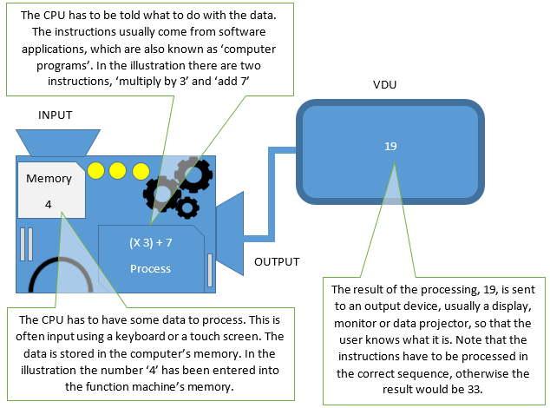
THE CPU

Slide 18
When a teacher asks you to do something, you listen (fetch), work out what you are being asked to do (decode) and then do it (execute). A CPU works in a similar way. It:
Fetches the instruction from memory
Decodes the instruction to find out what processing to do
Executes the instruction
This is known as the Fetch – Execute Cycle
How the CPU works
Fetch
Execute
Decode

Slide 19


The Decimal Number System
At school, you learn how to use the decimal number system – that is units, tens, hundreds and thousands. The decimal number system is also known as base 10 because it uses ten different numbers – 0, 1, 2, 3, 4, 5, 6, 7, 8, 9 - to make an infinite number of combinations.
Computers are electronic devices that use just two data values, 0 and 1. They can tell the difference between a high voltage and a low voltage, so we use high voltage to represent 1 and a low voltage to represent 0. Using two values, 1 and 0, to represent numbers is known as binary or base 2. All data in a computer must be in binary, so anything that is to be processed or transferred between computers, including all words, sounds and images, must first be converted into a series of 1s and 0s.
Decimal: the system that is normally used for counting and computation. It uses ten digits, and can be referred to as base 10.
Binary: A number system which uses two digits, 0 and 1. All electronic computation is carried out using the binary system. The binary number system is also called base 2.

Slide 20




This is a really important concept in computing. It makes us think that we can have 2 different options.
A Light switch can be set to ON...
…Or OFF

Slide 21


Imagine an electronic circuit with three lights, each controlled by its own switch. You can switch the lights on in many different patterns. Now imagine that each pattern represents a number, and each number relates to a message in a code book
How many different combinations could you make with:
One Lightbulb?
Two Lightbulbs?
Three Lightbulbs?
Using this information, how many do you think you could make with 4 lightbulbs?

Slide 22
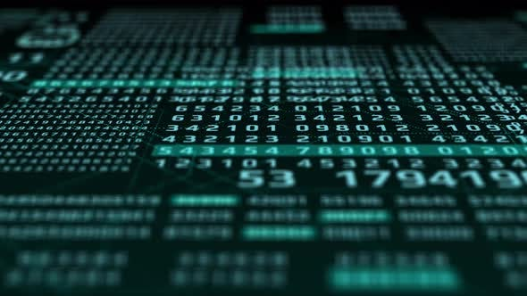

Binary Video
You’re going to watch a video now on Binary and data in general. There is some really important information to be found here – about how computers can understand numbers, show text on the screen, and even how images, videos and sound work!
Binary Research
A) Copy and extend the table below as required. Complete the cells for all the different binary combinations you can make. The First few cells have been done for you!
B) What pattern can you spot when working out the largest number with a given number of bits?
C) Research the invention in 1836 by a man called Samuel. HINT: This is related to this binary idea dot-dash.
1 Bit | 2 Bits | 3 Bits | 4 Bits
0 | 00 | 000
1 | 01 | 001

Slide 23



Converting Binary

Slide 24

Adding Binary

Slide 25
Adding in Binary

Slide 26
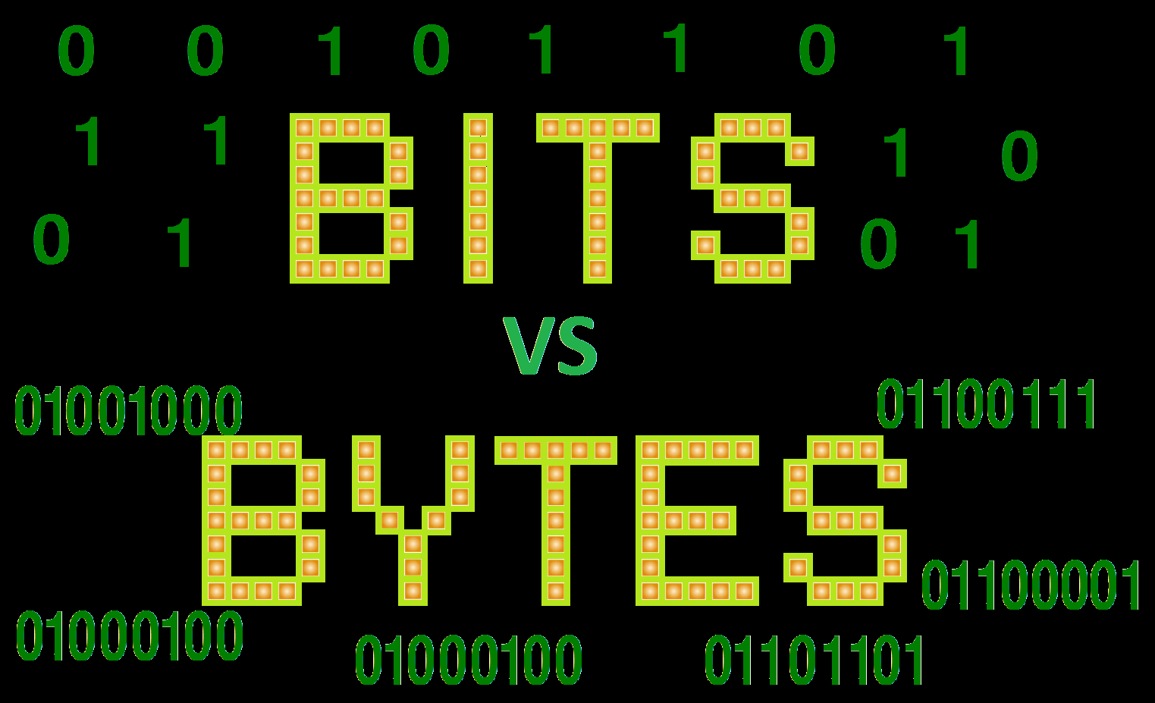

Slide 27
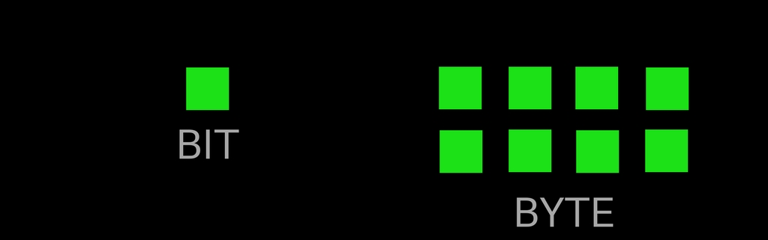
Computers use electrical circuits to process data.
These circuits require the data to be in a digital form as a string of binary digits, or 1s and 0s.
A bit is the name given to one binary digit and is the smallest piece of data that a computer can process.
All the data stored on, and processed by, a computer is simply a long series of bits.
To give an idea of scale, a single letter of text, for example the letter ‘a’, is represented by eight bits.
You have seen how a computer represents letters and numbers.
Sound is digitised by sampling it at intervals, and images are digitised by representing coloured dots with binary numbers.
This idea of 1’s and 0’s is the underlying principle of computers.

Slide 28
What Do these terms mean?
Kilobyte
Megabyte
Terabyte

Slide 29
Background Disappeared. Insert Creative Wallpaper Background here.
☹
Unit | Size
Bit | A binary digit, 1 or 0
Nibble | 4 bits
Byte | 8 bits
Kilobyte | 1024 bytes
Megabyte | 1024 kB
Gigabyte | 1024 MB
Terabyte | 1024 GB
Petabyte | 1024 TB
The terms ’kilobyte’ and ‘megabyte’ are used to describe the size of the storage space inside a computer; the amount of memory available to store data for use when processing and to store the output of the processing in the form of files.
The prefix ‘kilo’ means thousand and ‘mega’ means million, so a ‘megabyte’ is one million bytes.

